Slide 1
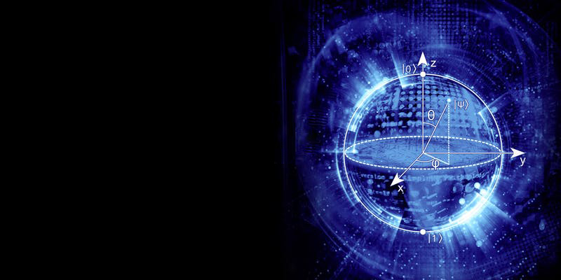
Quantum image processing
Case study: Cities at Night
TEAM 24
Harold Co
Elena Peña Tapia
Nozomi Tanetani
Jean Philippe Arias Zapata
Lucía García Sánchez-Carnerero
COACHES:
Marina Aisa, Yaiza García, Gregorio Iniesta.

Slide 2
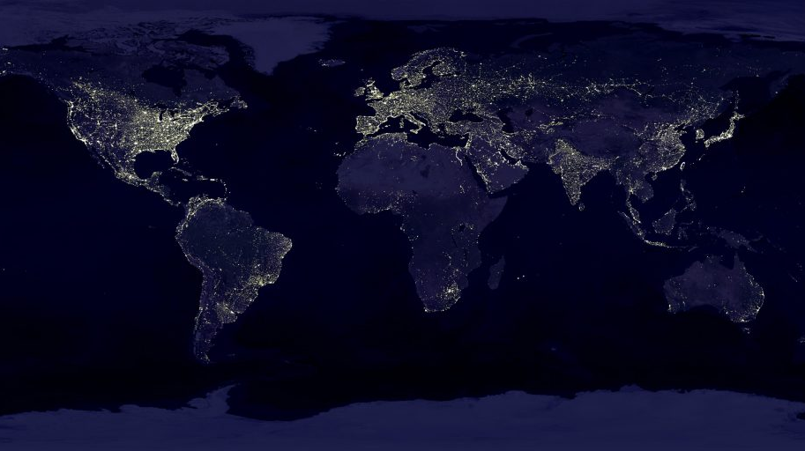
Notes:
This is the best map of the world at night that exists. You may think is beautiful, unless you realize that when you zoom in Tokyo:

Slide 3
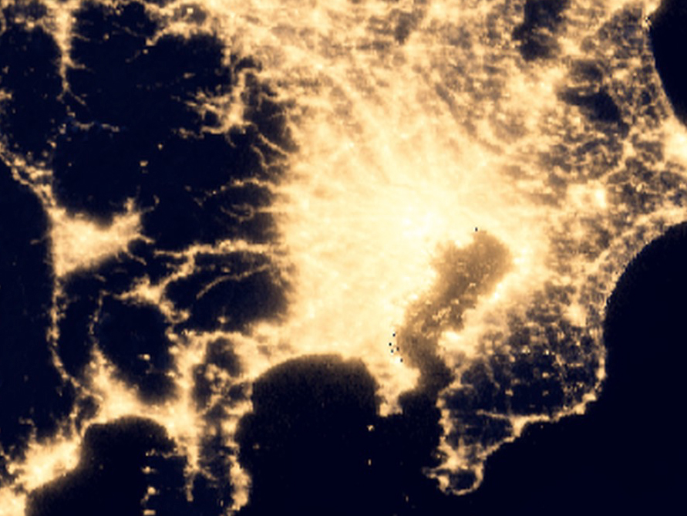
Tokyo at night right now
Tokyo at night
Notes:
You get a blurry image. But what if I told you there is a way of getting this resolution:

Slide 4
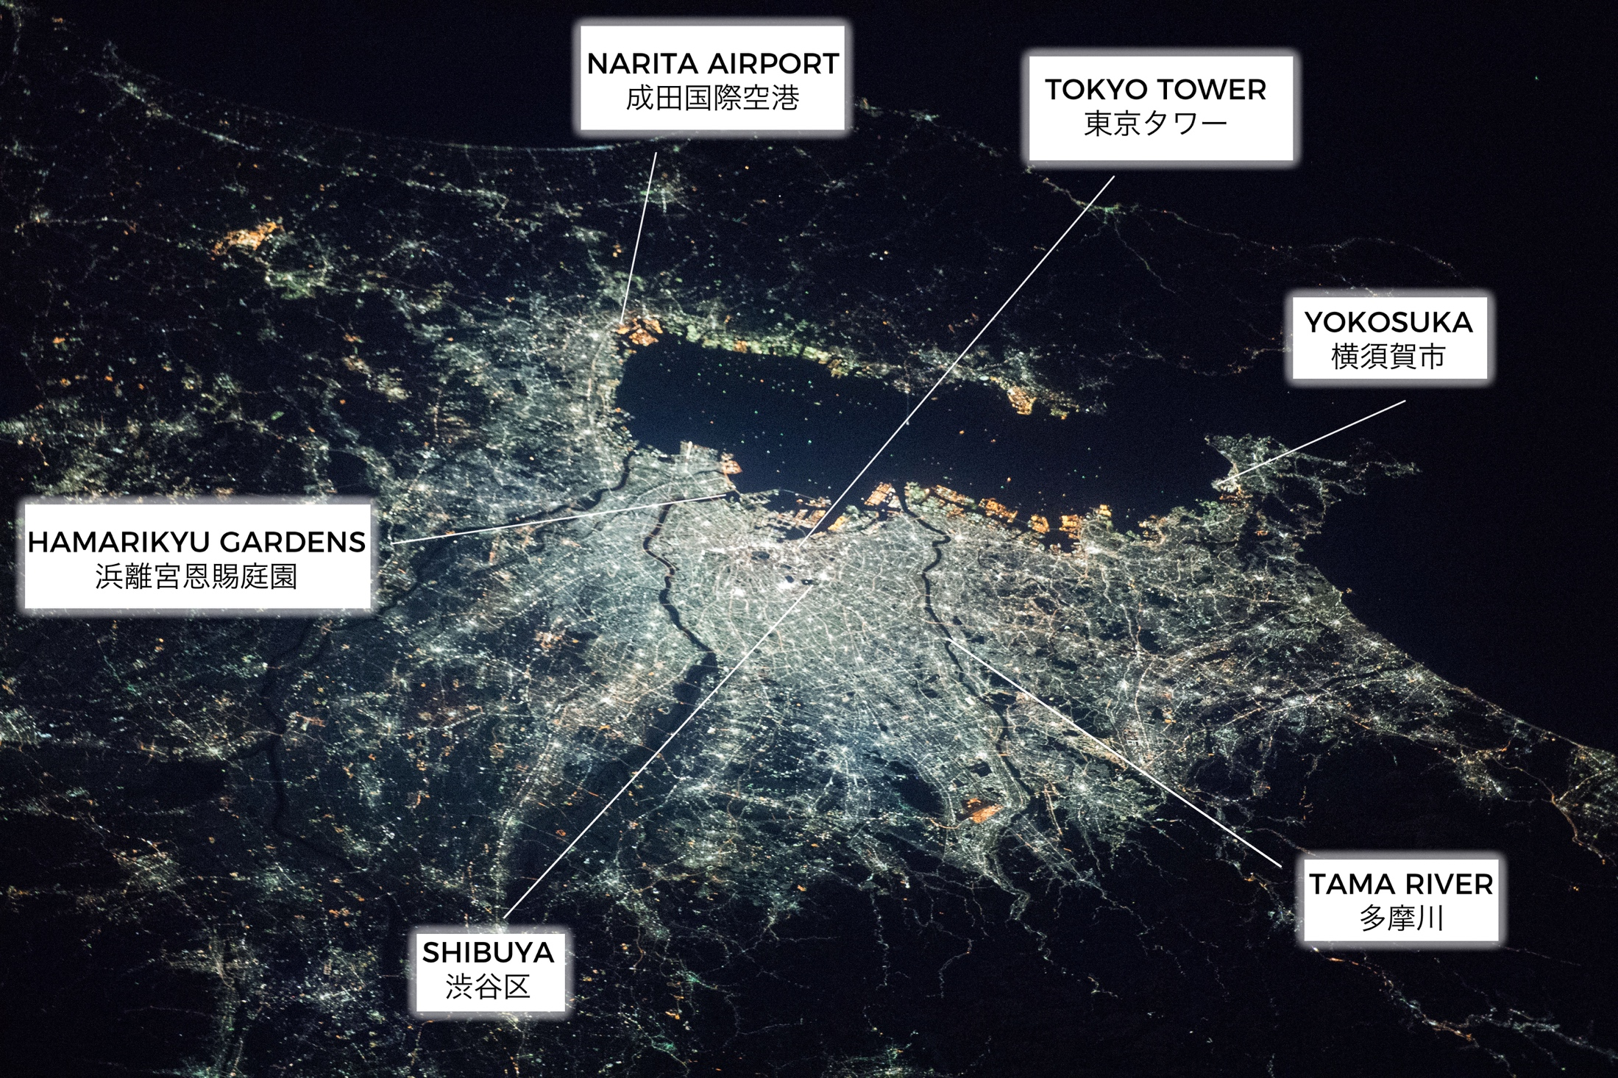
Tokyo at night
Notes:
that allows you to locate details of the city such as dark parks, rivers and even individual buildings. This picture was taken…

Slide 5
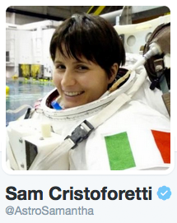
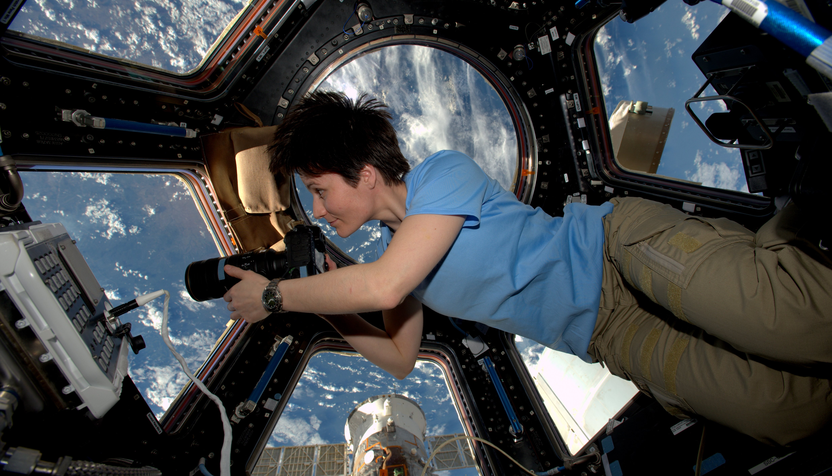
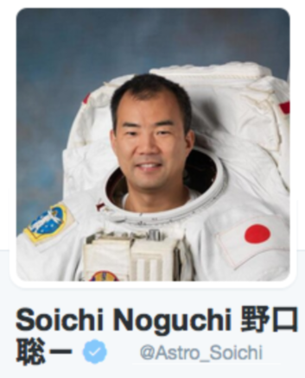

Pictures taken by astronauts onboard the ISS
Notes:
…by an astronaut onboard the ISS.
NASA has a database with almost 1 million cluttered, unlabeled pictures like this that my research group on light pollution would like to use to create a map of the earth at night.
Trying to do it with classical computers has probe to be ineffective so

Slide 6
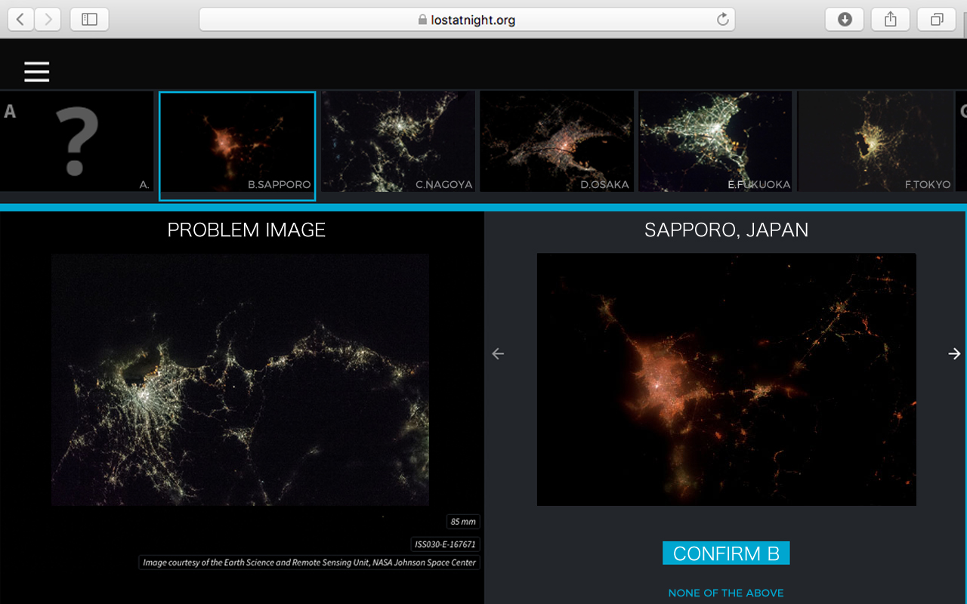

Notes:
Researchers at cities at Night project are using citizen science to get manual matching.
They give people a problem image like and ask them… is this Tokyo, Sapporo, Nagoya maybe…?

Slide 7
1
2
3
4
Image matching with Qiskit:
Classical image preparation
Quantum encoding
Quantum edge detection
Quantum matching

Slide 8
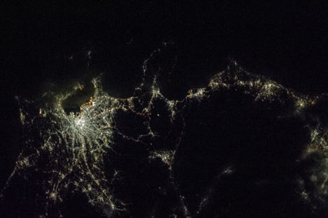
1
2
3
4
1. Image preparation
Tokyo
Simply Tokyo
What?
Grey scale
32x32 pixels
10+1 qubits
(10+ 1qbits)
Why?
# qubits <32
# gates (depth)

Slide 9




1
2
3
4
2. Quantum encoding FRQI
(Flexible Representation of Quantum Images)
$$F_{ij}→\frac{1}{2n}\sum_{k=0}^{2^{2n}−1}{(cosθk⁡|0> +sinθk{|1>})\left[\left.k\right\rangle \right.}$$
What?
Classical bit / pixels qubits
Why?
Advantage m pixels N = log₂ (m) qubits
But
Data loading: m gates m pixels
$$\sim$$

Slide 10
1
2
3
4
2. Quantum encoding
Alternative: log concave
Reduce # gates
Assumption: log concave image probability distribution
Classical probability distribution mapped to probability
amplitude of
quantum states.
Encoding | Classical | Quantum FRQI | Quantum Log concave
Pixels | m bits | log₂m qubits | log₂m qubits
Gates | ⁻ | m | log₂ m

Slide 11
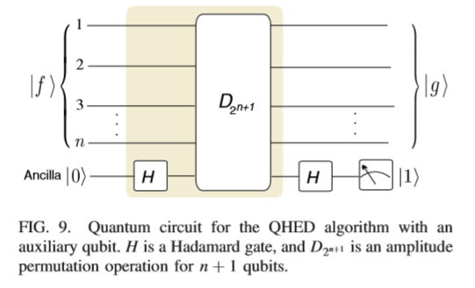
1
2
3
4
3. Quantum edge detection
Source: Yao, X. W., Wang, H., Liao, Z., Chen, M. C., Pan, J., Li, J., ... & Zheng, W. (2017). Quantum image processing
and its application to edge detection: Theory and experiment. Physical Review X, 7(3), 031041.

Slide 12
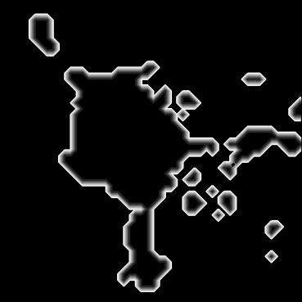
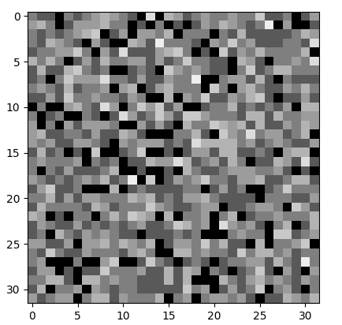
1
2
3
4
3. Quantum edge detection
Classical edge detection
Quantum edge detection

Slide 13
1
2
3
4
4. Quantum matching
Problem picture
5 options

Slide 14
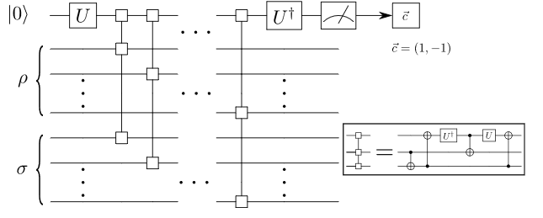
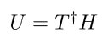
1
2
3
4
4. Quantum matching
Quantum based similarity method: Swap
Source: Cincio, L., Subaşı, Y., Sornborger, A. T., & Coles, P. J. (2018). Learning the quantum algorithm for state
overlap. New Journal of Physics, 20(11), 113022.

Slide 15


1
2
3
4
4. Quantum matching
Shots 1024
Simulation time taken 34m 4.8s
Problem Tokyo
89.551%
10.449%
0 1

Slide 16
1
2
3
4
4. Quantum matching
Shots 1024
Simulation time taken 30m 18.5s
Problem Sapporo
60.938%
39.063%
0 1

Slide 17
References
[1] Yao, X. W., Wang, H., Liao, Z., Chen, M. C., Pan, J., Li, J., ... & Zheng, W. (2017).
Quantum image processing and its application to edge detection: Theory and experiment. Physical Review X, 7(3), 031041.
[2] Le, P. Q., Dong, F., & Hirota, K. (2011).
A flexible representation of quantum images for polynomial preparation, image compression, and processing operations.
Quantum Information Processing, 10(1), 63-84.
[3] Le, Q. P., Fangyang, D., Yoshinori, A., & Kaoru, H. (2009).
Flexible representation of quantum images and its computational complexity analysis. I
In 日本知能情報ファジィ学会 ファジィ システム シンポジウム 講演論文集
第 25 回ファジィ システム シンポジウム (pp. 185-185). 日本知能情報ファジィ学会
[4] Yuan, Suzhen & Venegas-Andraca, Salvador & Wang, Yuchan & Luo, Yuan & Mao, Xuefeng. (2019).
Quantum Image Edge Detection Algorithm. International Journal of Theoretical Physics. 10.1007/s10773-019-04166-9.
[5] Gómez-Moreno, H., Maldonado-Bascón, S., López-Ferreras, F., Acevedo-Rodríguez, F. J., & Martín-Martín, P. (2001).
Edge detection by using the support vector machines. training, 2, 3. [6] Cincio, L., Subaşı, Y., Sornborger, A. T., & Coles, P. J. (2018).
Learning the quantum algorithm for state overlap. New Journal of Physics, 20(11), 113022.

Slide 18
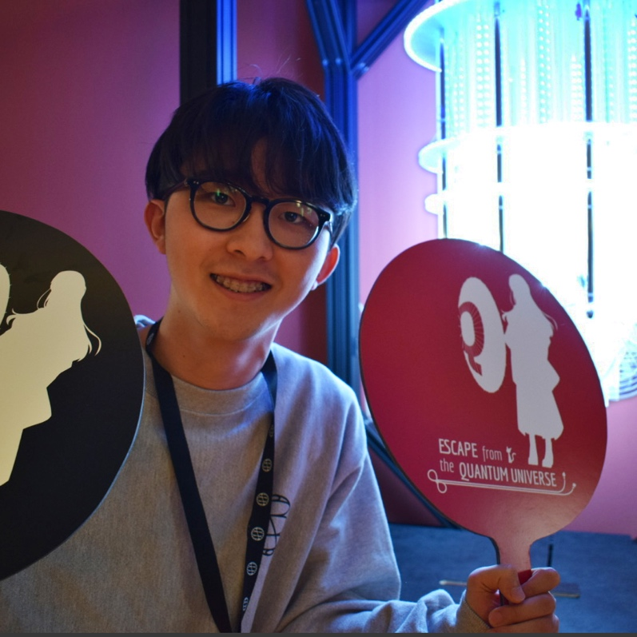
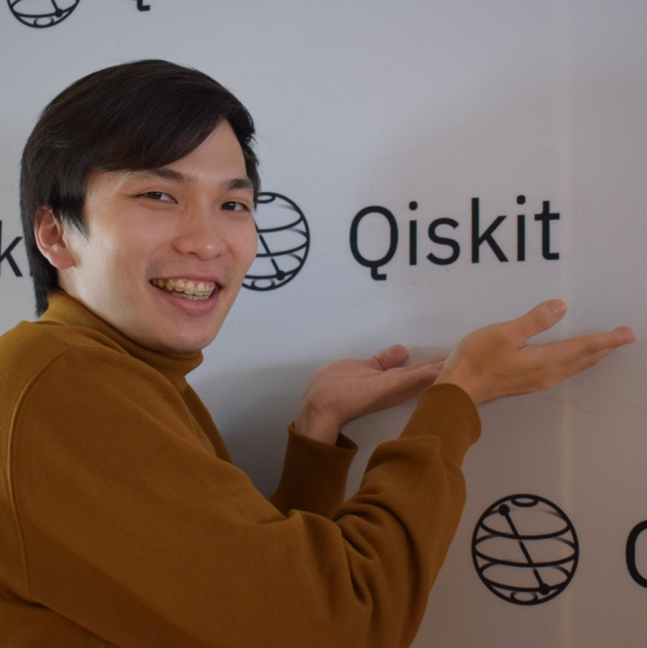
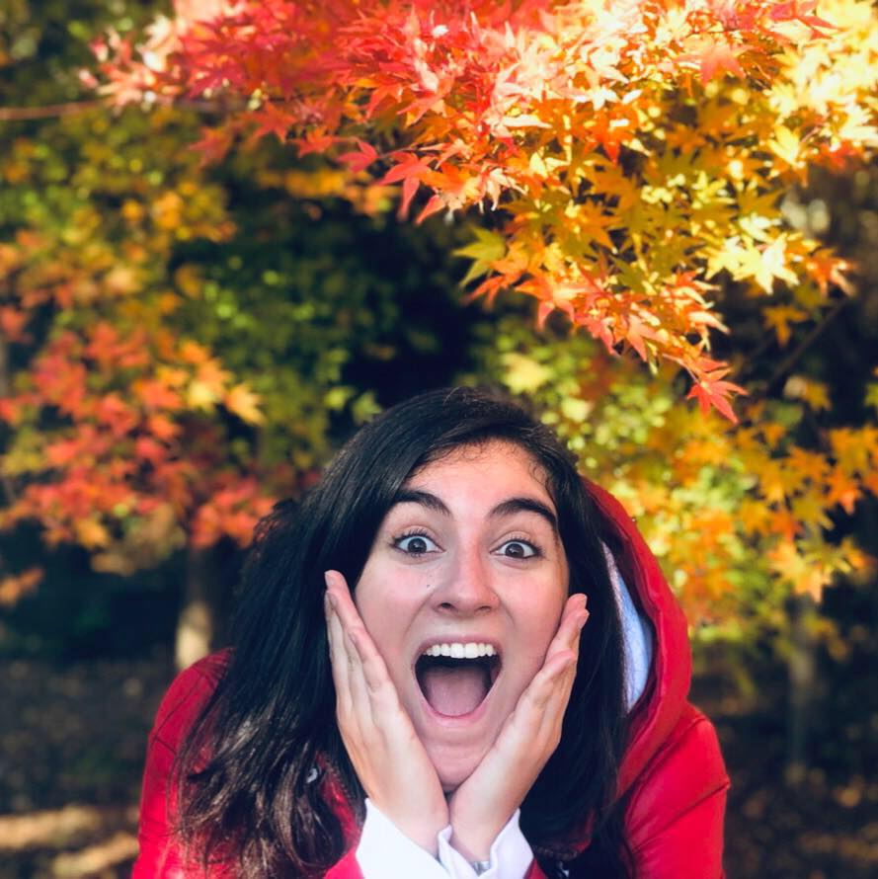
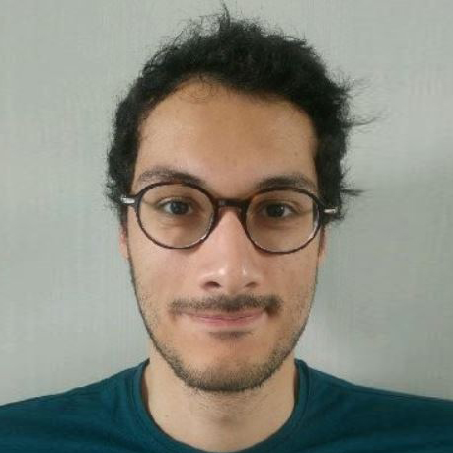
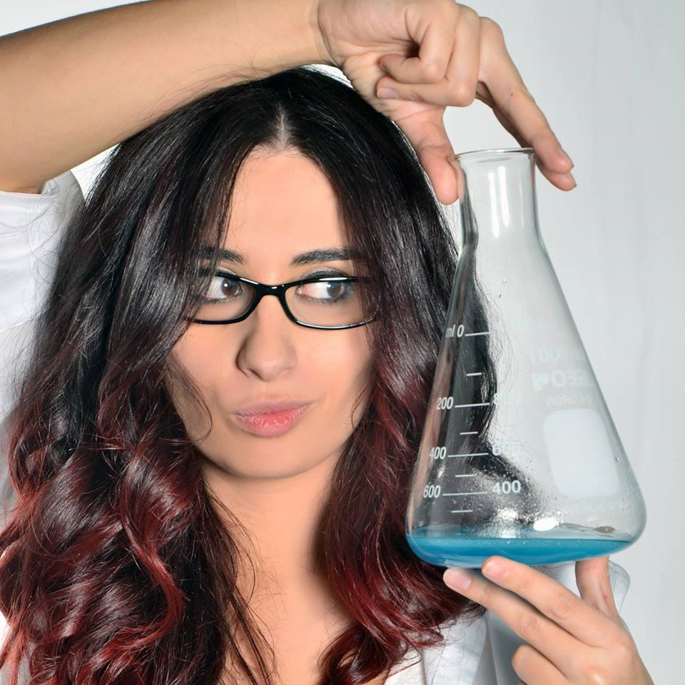
Team 24
Elena Peña
Robotics & DL engineer
Nozomi Tanetani
Quantum engineer
Harold Co
Quantum optics
researcher
Thanks!
ありがとう
ございました
Jean Philippe Arias
Quantum finance researcher
Lucía García
Astrophysicist

